Slide 1

Puccini by mail Sentiment polarity prediction
Andrea Ierardi
Student’s ID: 960188

Slide 2
Project aim
Build prediction models and use pre-trained model to detect sentiment polarity in Puccini’s letters
Build Algorithm for data retrieval from Ricordi Archive
Comparison between models

Slide 3
Datasets
Two datasets:
The Ricordi Archive:
Extracted with a retrieval algorithm
500 letters received and sent by Giacomo Puccini
Sentipolc- evalita16:
Collection of Italian Tweets
Available in csv format in the website
7000 examples for training, 4000 example for testing

Slide 4
Ricordi Archive Extraction Algorithm
Two main URLs:
IDs URL: used for extraction of the letter IDs
Letters visualization URL: used for the extraction of information for the selected letter’s ID.
Extraction of the information using HTML fields:
<div> The Content Division element HTML
Separating different information searching for specific Div IDs
For the additional info newline separator have been considered

Slide 5
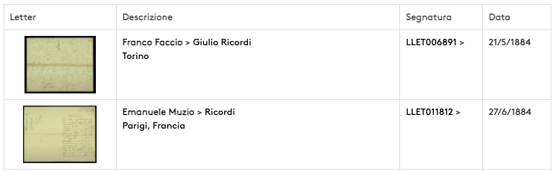
ID Extraction
For the iteration of the different pages we pass an incremental number as parameter
For each letter we extract the “segnatura” field which contains the letter’s ID

Slide 6
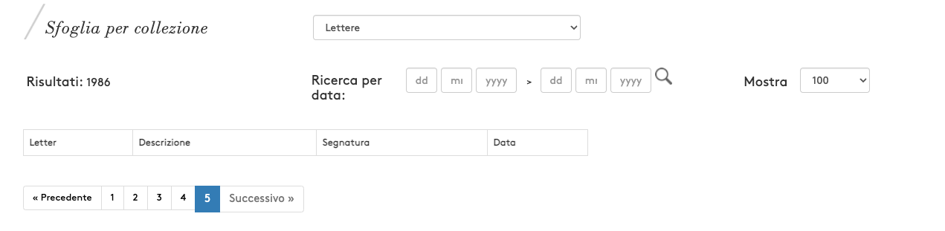
ID Extraction Problems
Setting page number high (for example) 200 a empty table is returned
SOLUTION: if the returned table is empty all the possible IDs have been examined and the first phase of the algorithm stops

Slide 7
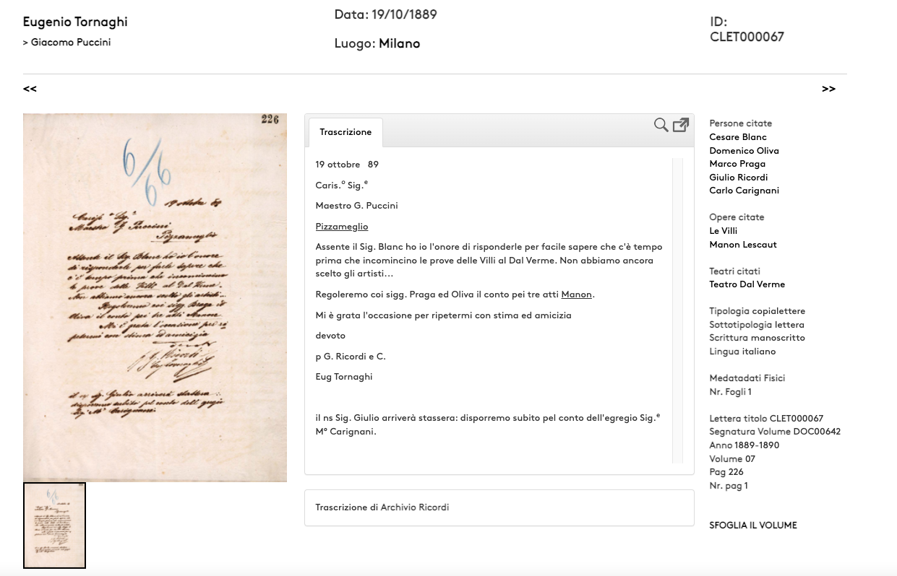
Information Extraction
Retrieved IDs in the first phase are appended in the second URL
Appending the letter’s ID at the end of the we obtain the letter information

Slide 8
Information Extraction
Main Information
Transcribed Text
Additional Information

Slide 9
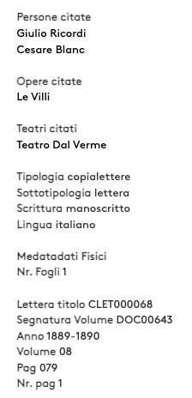



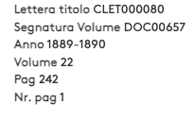
Information Extraction Problems
Discordance between letters in the additional information field:
SOLUTION: set dataframe cell with null value if information is missing
Div id | Page 1 | Page 2
letter-show-details-named-people
letter-show-details-named-works |  | NULL
letter-show-details-named-teatri |  | NULL
letter-show-details-tipologia letter-show-details-sottotipologia letter-show-details-scrittura letter-show-details-linuga
letter-show-details-metadati-fisici
Outside a div
Andrea Ierardi

Slide 10
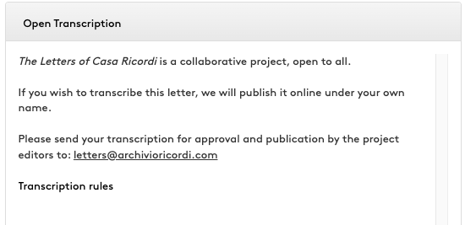
Information Extraction Problems
Letter’s text in some cases is not already transcribed from the original
SOLUTION: Skip this letter in the algorithm
Andrea Ierardi

Slide 11
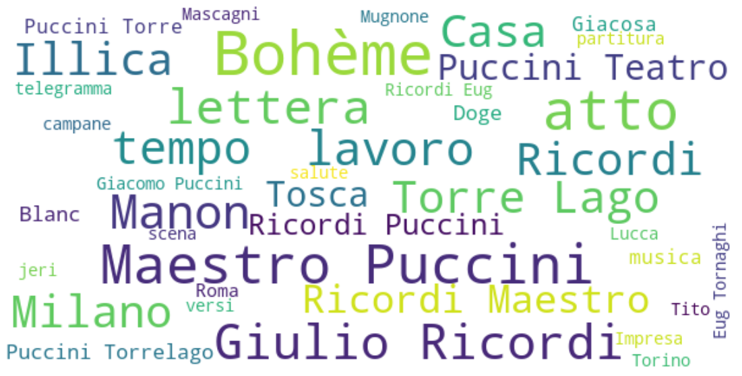
Letters Word Cloud
Most common words are related to music, Puccini works, friends and collaborations:
Works:
Bohème, Manon Lescaut.
Friends and colleagues:
Tito is the name of Tito II Ricordi.
Luigi Illica and Giuseppe Giacosa are famous librettists whom Puccini worked.
Puccini conservatory room mate Pietro Mascagni.
Leopoldo Mugnone
Italian cities:
Milan, Rome, Turin and Lucca
Torre lago: a small community nearby Lucca where from 1891 onwards Puccini, Puccini spent most of his time
Opera terms:
Music, score, verse, tempo, scene
Andrea Ierardi

Slide 12
Models
Pre-trained SentITA
Simple Neural Networks

Slide 13
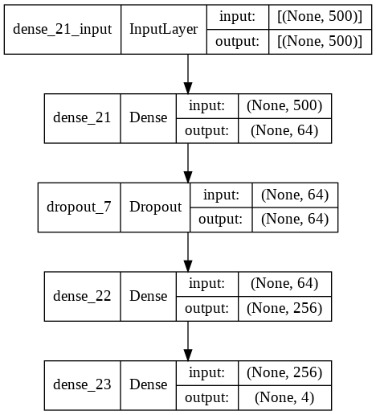
Neural Networks Architecture
Two types of Neural Networks have been constructed based on the number of sentiments in the target variable:
2-sentiments Neural Networks: Positive and Negative
4-sentiments Neural Networks: Positive, Negative, Neutral, Both Positive and Negative
Simple Neural Network architecture

Slide 14
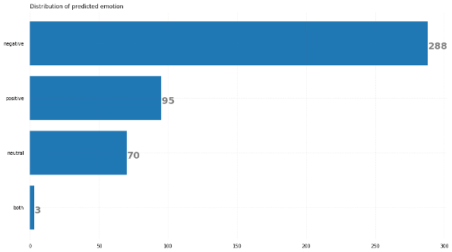
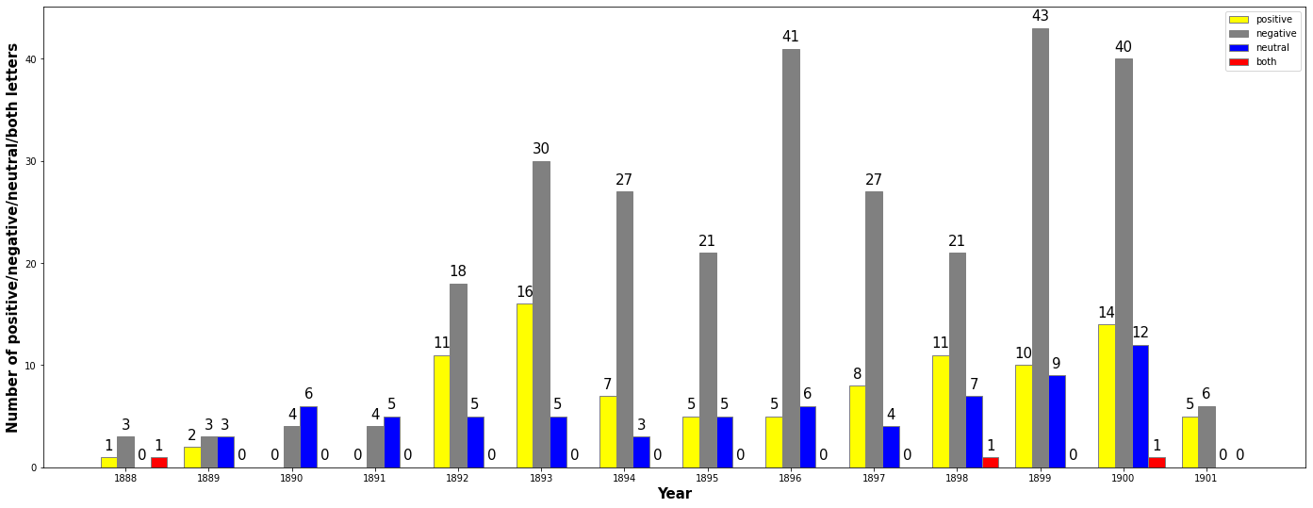
Neural Networks 4-sentiment
SentiPolc Test set result:
F1 score: 0.467 - Accuracy: 46.22 %
Model result on Puccini’s letters:
Predictions with 4-sentiments model
Predictions with 4-sentiments model over the years

Slide 15
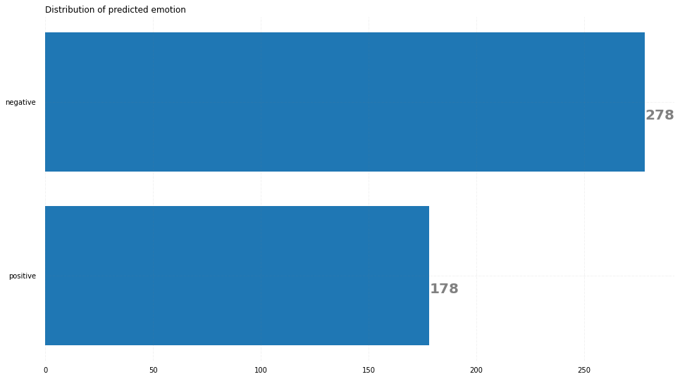
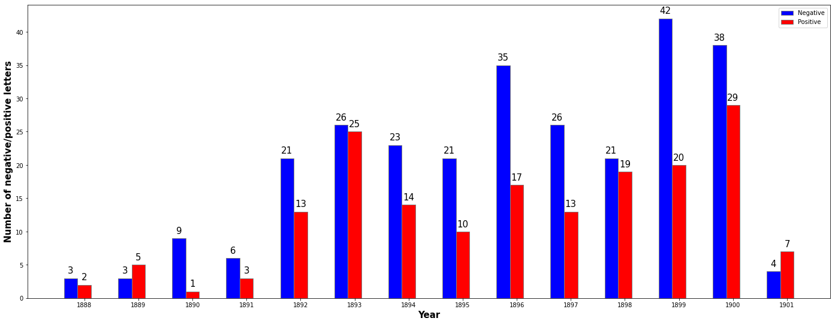
Neural Networks 2-sentiment
SentiPolc Test set result:
F1 score: 0.627 - Accuracy: 61.89 %
Model result on Puccini’s letters:
Predictions with 2-sentiments model
Predictions with 2-sentiments model over the years

Slide 16
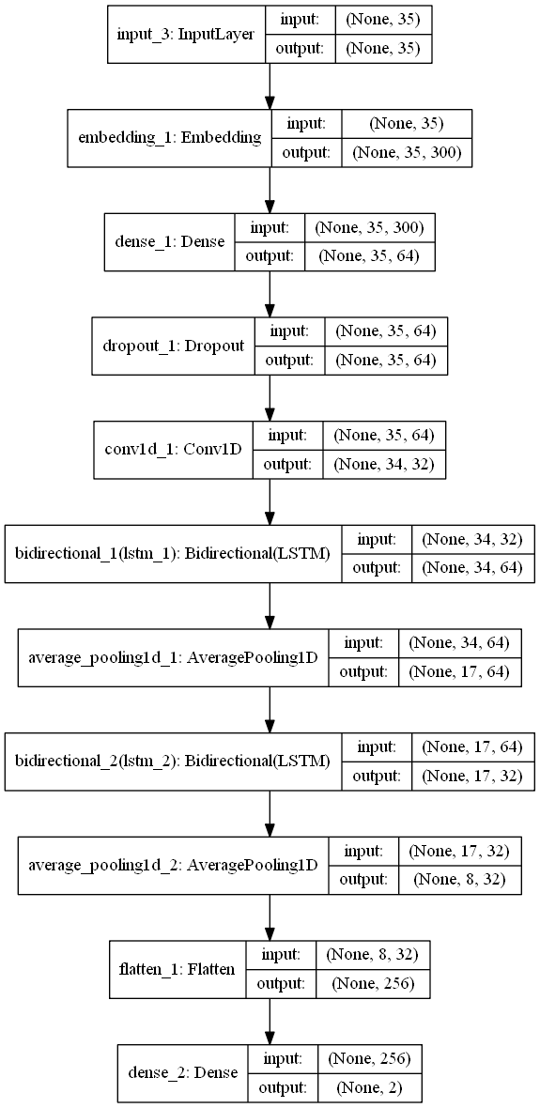
SentITA Architecture
The model receives in input a word embedding representation of the single words
Trained on few datasets (Sentipolc2016, AB- SITA2018 + Wikipedia).
Train and test the model comprises about 102k sentences of which 7k positives, 7k negatives and 88k neutral.
Bidirectional LSTM-CNN Neural Network architecture

Slide 17
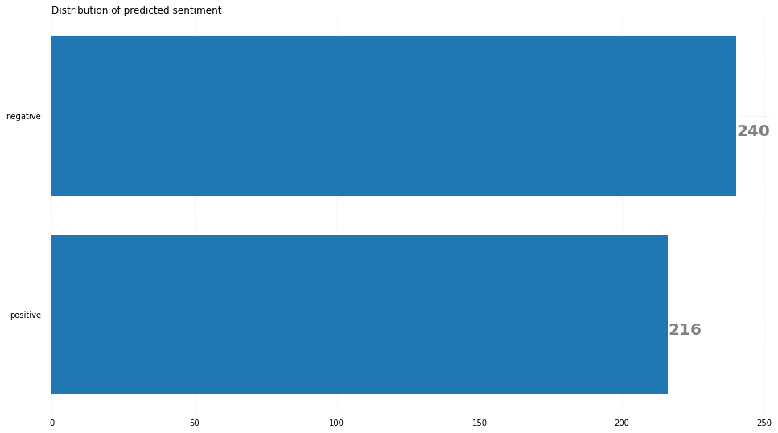
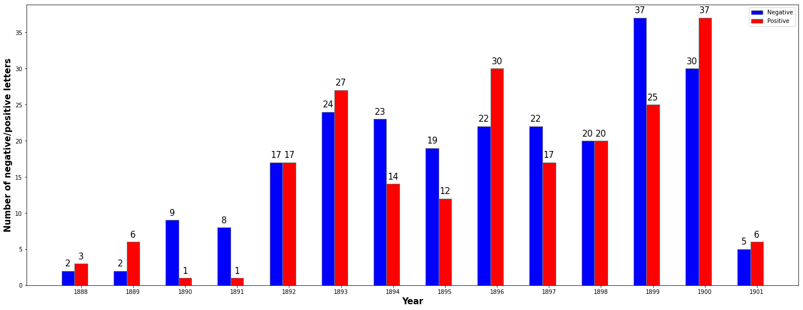
SentITA sentiment polarity
SentiPolc Test set result:
F1 score: 0.85
Model result on Puccini’s letters:
Predicted sentiment with SentITA model
Predicted sentiment with SentITA model over the years

Slide 18
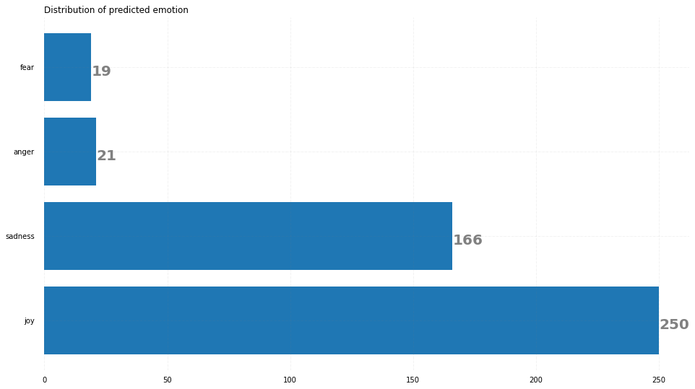
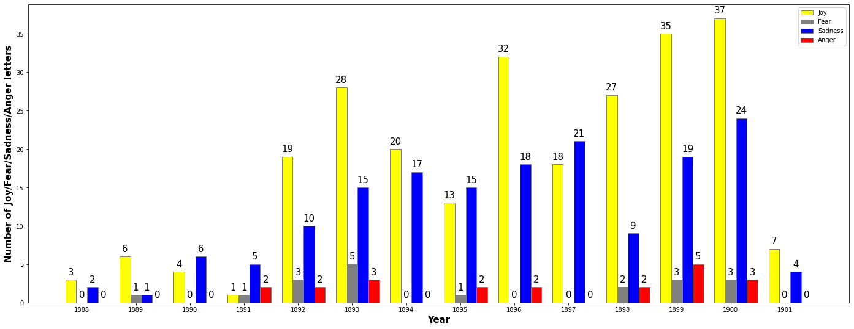
SentITA emotion
There is not information about emotions in SentiPolc dataset
Model result on Puccini’s letters:
Predicted sentiment with SentITA model
Predicted sentiment with SentITA model over the years

Slide 19
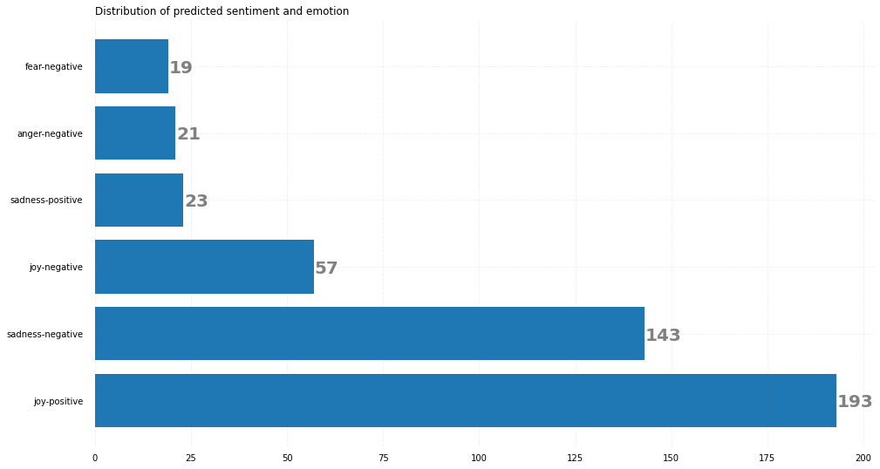
SentITA emotion and sentiment
There is not information about emotions in SentiPolc dataset
Model result on Puccini’s letters:
Predicted sentiment with SentITA model

Slide 20
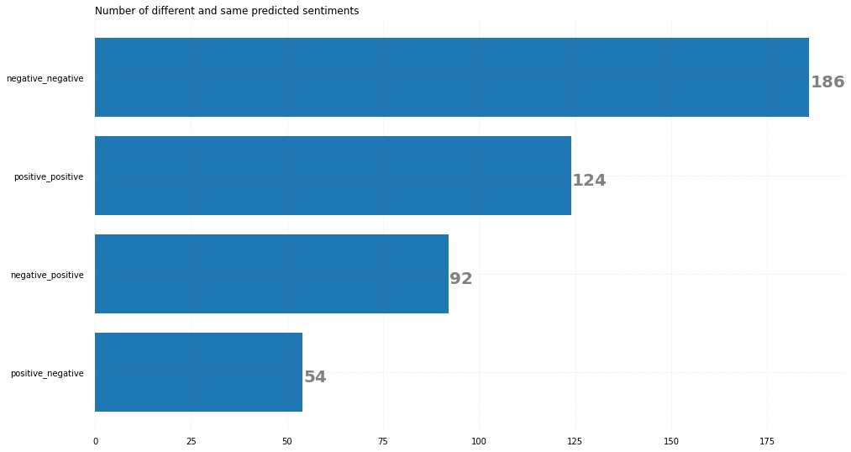
Neural Networks vs. SentITA
Comparison between Simple Neural Networks model and SentITA model
Only the sentiment polarity model have been compared
Model result on Puccini’s letters comparison:
Comparison between 2-sentiments Neural Networks and Sentita models
Most of the letters are predicted with the same sentiments
68% of the letters are classified by the same sentiment by the two models

Slide 21
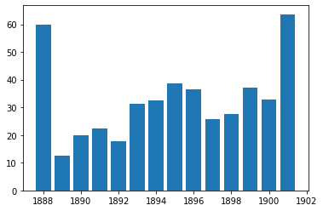
Neural Networks vs. SentITA
Comparison between Simple Neural Networks model and SentITA model
Model result on Puccini’s letters comparison:
Percentage of discordance in predicted sentiments - Neural Networks vs. SentITA
Most letters are distribuited in the years in the middle
Percentage is higher in 1888 and 1902 since number of letters in that years is lower
Percentage discordance stays under 40% in the other years
percentage
year

Slide 22
Conclusions & Next Steps
Conclusions
Retrieval algorithm worked well
SentITA performs better, due to the large training datasets combination but 2-sentiments is much faster to train and for this reason it may be a simple and reliable baseline
Next Steps:
Develope a model for emotions detection
Use also other features retrieved to train the model (source, receiver, date, place, volume, volume signature, year, page, number of pages ecc.)

Slide 23

Questions?

